Slide 1


Plasmonic nanosystems for cancer treatment
Futuro in AREA
>>sharing experience
promoting network
Fabio Vischio, IPCF-CNR
Bari, 23/10/2019

Slide 2
AGENDA
1
Cancer: a still incurable disease
Report of 2018 on cancer in the world.
Biology of cancer: two important mechanisms
2
Two important mechanisms to fight the cancer.
3
Nanoparticles: a new platform for treatment of tumors
The new nanotechnologies as new approaches for an efficacious treatment of cancer.
4
New multifunctional plasmonic nanosystems
Example of new multifunctional plasmonic nanoparticles-based systems.
Notes:
Image source:-
https://pixabay.com/en/technology-industry-big-data-cpu-3092486/

Slide 3

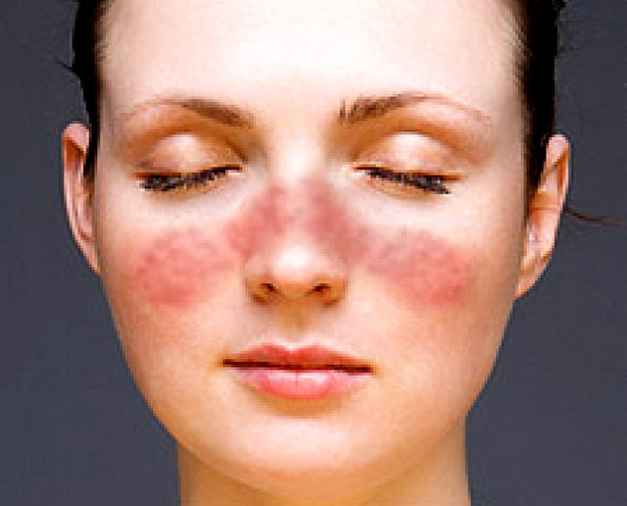
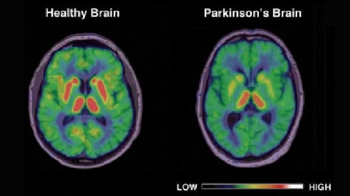

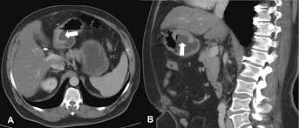
Cancer: a still incurable disease
Alzheimer’s disease
Diabetes
HIV/AIDS
Parkinson’s disease
Multiple sclerosis
Lupus
Polio
Asthma
Schizophrenia
Cancer

Slide 4
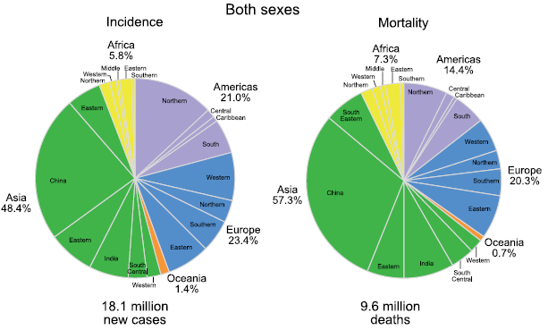
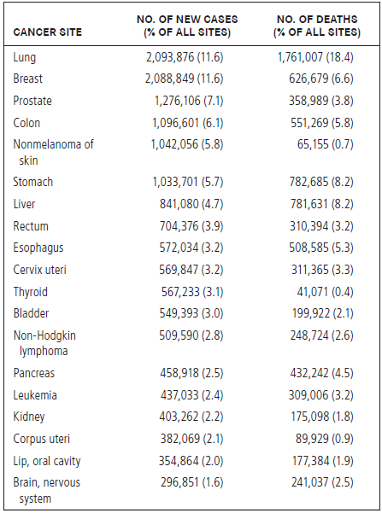
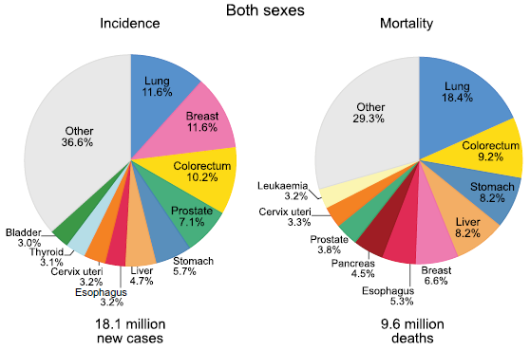
Cancer: a still incurable disease
New Cases and Deaths for the First 19 Cancers in 2018
Bray et al. Cancer J. Clin. 2018, 68, 394-424.

Slide 5
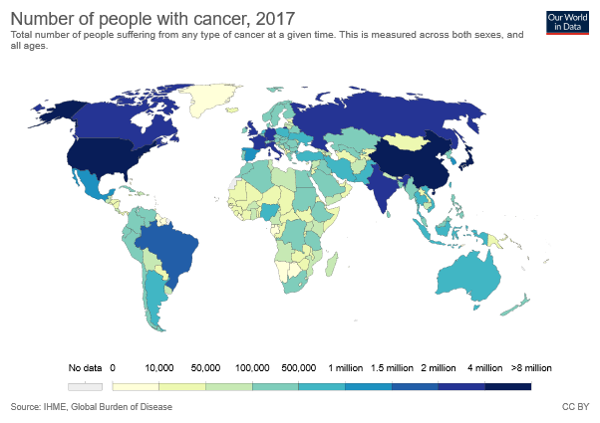
Cancer: a still incurable disease
The most frequently diagnosed cancer and the leading cause of cancer death, however, substantially vary across countries and within each county depending on the degree of economic development and associated social and life style factors. It is noteworthy that high-quality cancer registry data, the basis for planning and implementing evidence-based cancer control programs, are not available in most low- and middle income countries.
Bray et al. Cancer J. Clin. 2018, 68, 394-424.

Slide 6

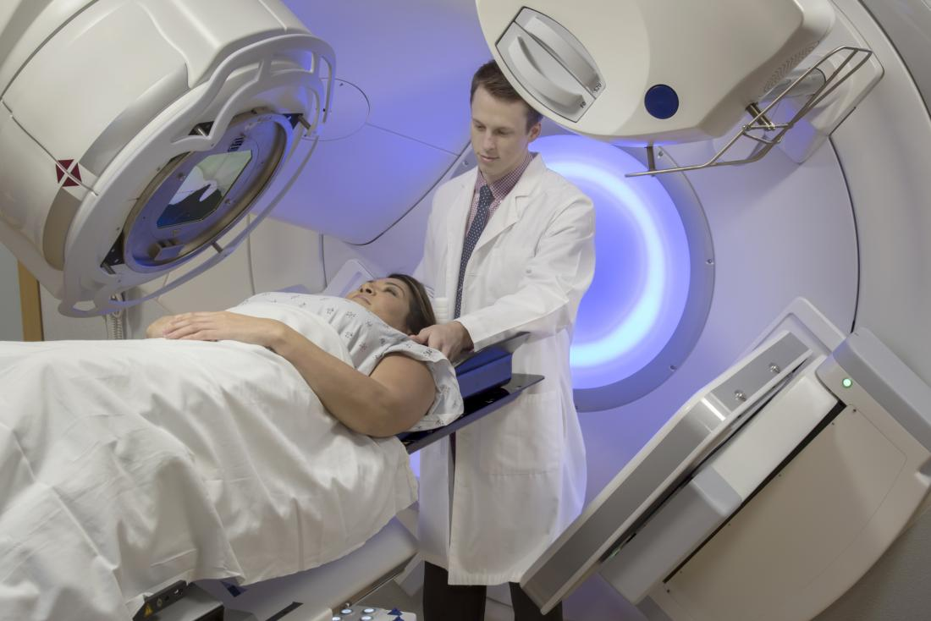
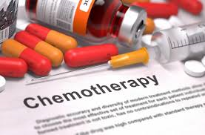
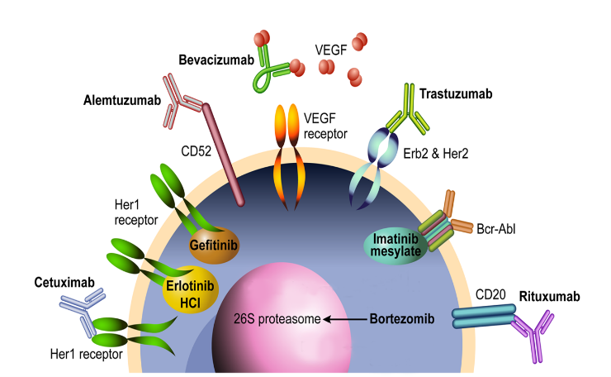
Cancer: a still incurable disease
Surgery: resection of tumor and part of surrounding tissues
Radiotherapy: bombardment of cancerous tissues with ionized radiations (X-rays and γ-rays) or with particles (electrons, α-rays, protons, carbon nuclei, etc.)
Chemotherapy: administration of cytotoxic drugs
Target therapy: administration of specific monoclonal antibodies or extracellular growth factors or administration of small molecules in order to interact with enzyme activity on the purposive protein.

Slide 7
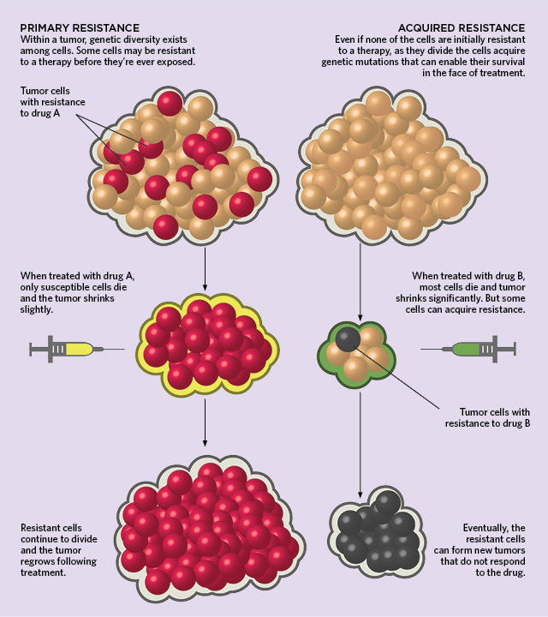
Cancer: a still incurable disease
Toxicity of potential anti-cancer agents: barrier to therapeutic benefit
Limitations of Macromedicine:
Microscopical residual
Functional damage to organs
Resistance in cancer cells
Side effects of therapies
Needs:
Improved biodelivery (safety)
Targeting tumors
Limit exposure of healthy tissues and organs to cytotoxics

Slide 8
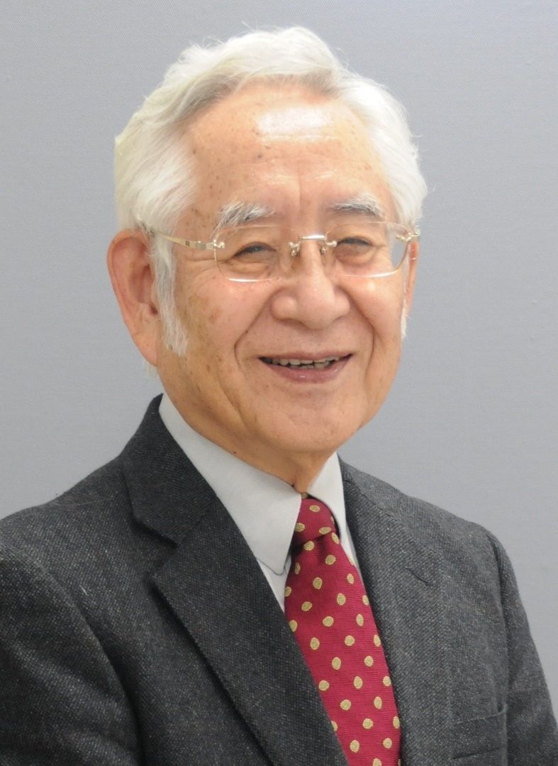
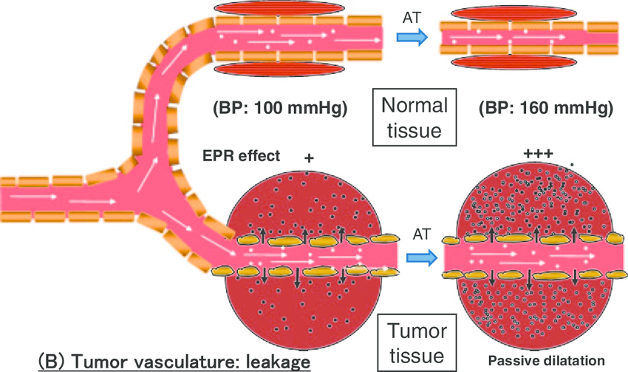
Biology of cancer: two important mechanisms
Enhanced Permeability and Retention (EPR) Effect
Hiroshi Maeda (1938- )
Maeda H, Proceedings of the Japan Academy Ser B Physical and Biological Sciences, 2012, 88(3), 53-71

Slide 9
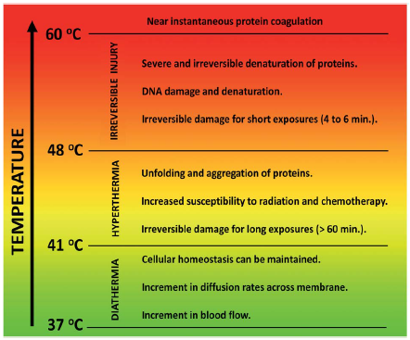
Biology of cancer: two important mechanisms
Hyperthermia Treatments: Increase of Cell Temperature
These thermal treatments consist in setting the temperature of a tumor within the 41–48 °C temperature range.
“Severe” hyperthermia treatments (43–45 °C) cause long term cell inactivation. In this temperature range, the rate of biochemical reactions is significantly increased and this leads to the appearance of oxidative stress due to the increment of the intracellular density of reactive oxygen species.
“Suppressive hyperthermia” (45–48 °C) produces rapid necrotic cell death in cancer cells that are resistant to standard hyperthermia.
Jaque D, Nanoscale, 2014, 6, 9494-9530

Slide 10
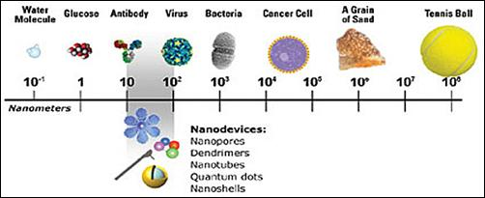
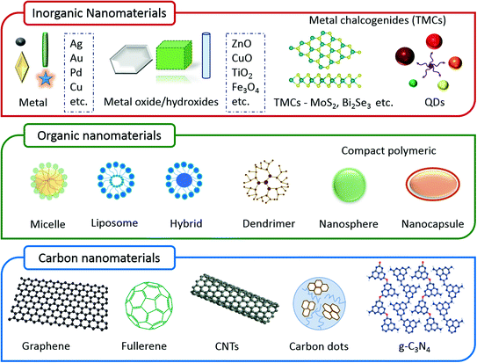
Nanoparticles: a new platform for treatment of tumors
Nanomaterials: definitions
A natural, random material or product containing particles, in a loose state or as an aggregate or as an agglomerate and where one or more external dimensions are in the range of 1 nm - 1000 nm.
1 nanometer (nm) = 10⁻⁹ meters
Kumar N., Sinha Ray S. (2018) Synthesis and Functionalization of Nanomaterials. In: Sinha Ray S. (eds) Processing of Polymer-based Nanocomposites. Springer Series in Materials Science, vol 277. Springer, Cham

Slide 11
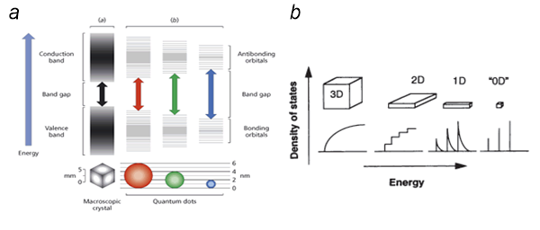
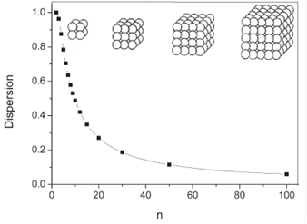
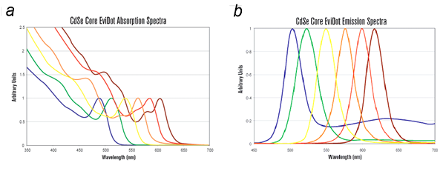
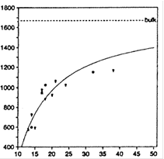
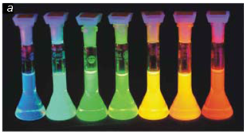
Nanoparticles: a new platform for treatment of tumors
Nanomaterials: some properties
Dispersion
Total number of atoms
Temperature (°C)
Transition pressure (GPa)
Radius (nm)
Radius (Angstrom)

Slide 12
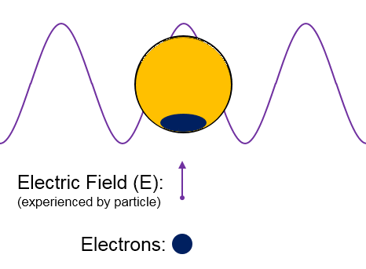
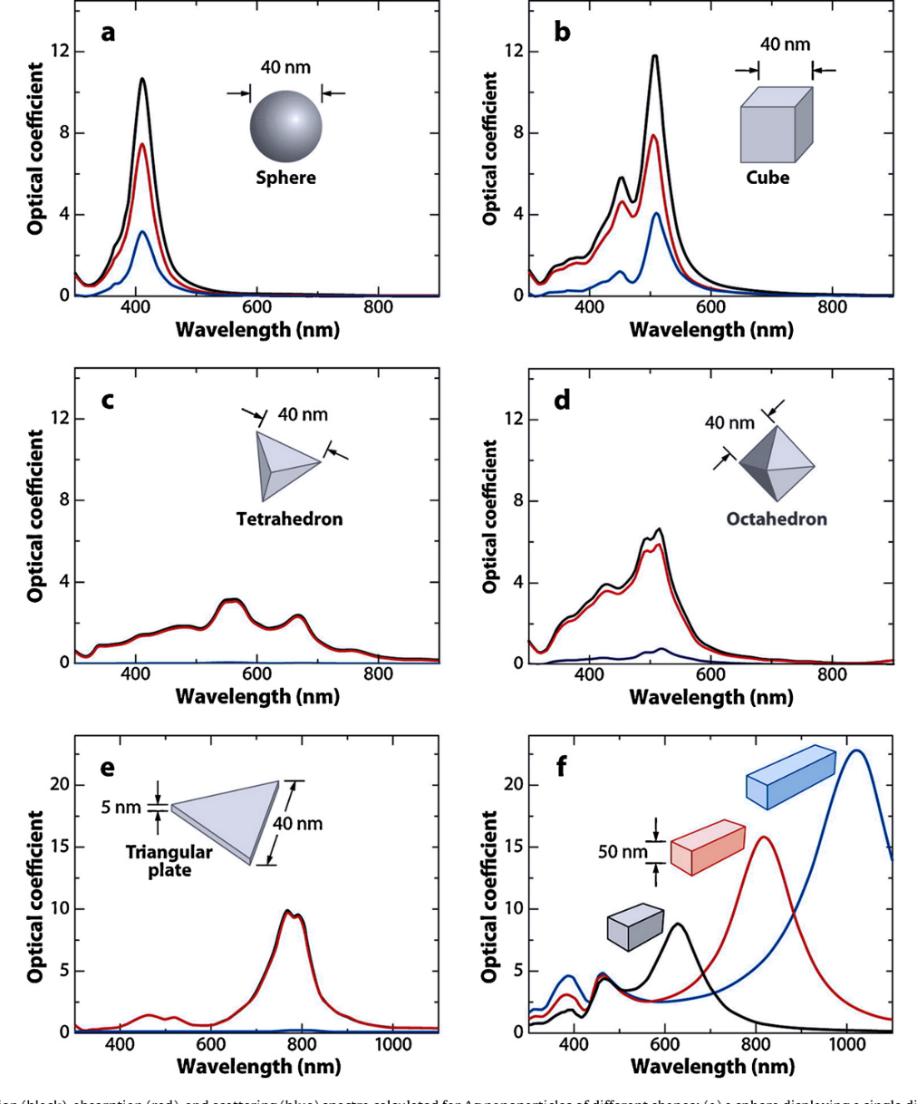
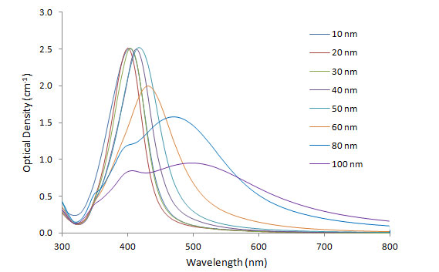
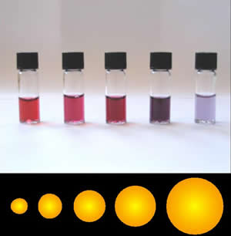
Nanoparticles: a new platform for treatment of tumors
Nanomaterials: plasmonic properties
Optical phenomenon that causes a collective oscillation of free carriers and subsequent absorption due to interaction between the incident photons and the nanostructure.
This phenomenon is shown in metallic and some semiconductor nanomaterials.
http://www.cytodiagnostics.com/store/pc/viewcontent.asp?idpage=11
Petryayeva E. et al. Anal. Chim. Acta 2011, 706(1), 8-24

Slide 13
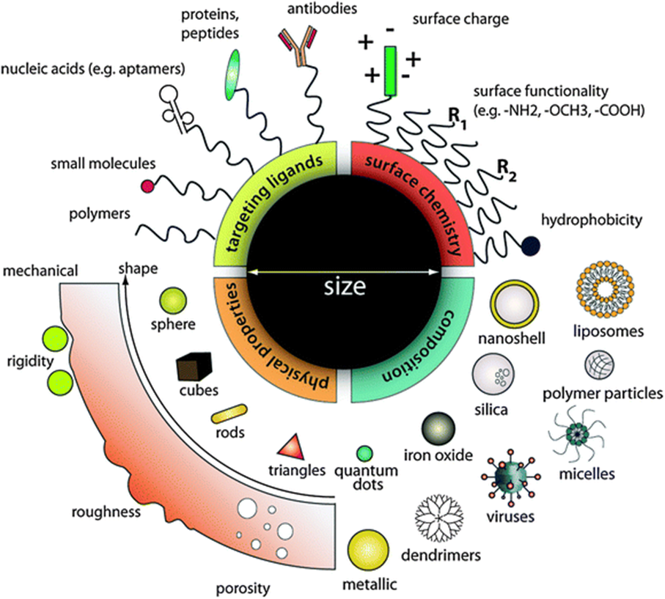
Nanoparticles: a new platform for treatment of tumors
Colloidal NPs: Requirements for Applications in Biomedicine
«in vivo» stability
Ability to be eliminated from the body through the reticuloendothelial system (RES)
Ability to be conveyed to target cells
Ability to be internalized by target cells
Diagnostic and / or therapeutic effects of colloidal NP strongly determined by
Size, shape and surface charge
Surface coating
Ligands for active targeting
Leo Y. et al. Chem. Soc. Rev., 40, 2011

Slide 14
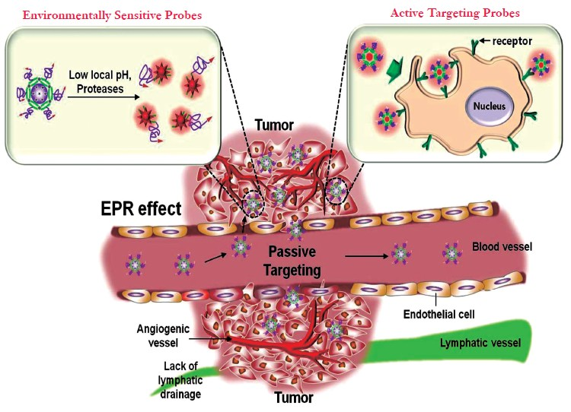
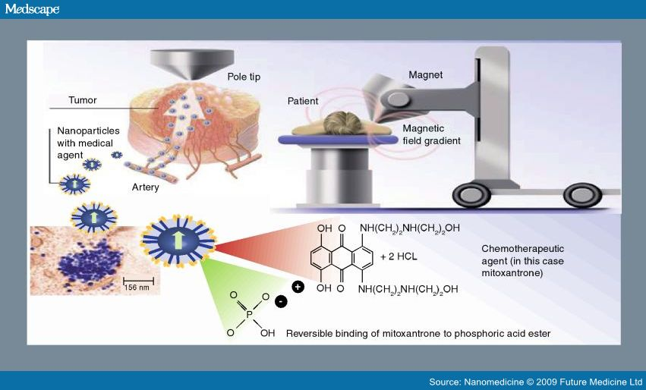
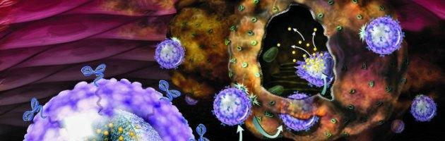
Nanoparticles: a new platform for treatment of tumors
Passive Targeting
Active Targeting
EPR effect
chemical targeting
physical targeting
Park K., Quant. Imaging Med. Surg. 2(2), 2012
Nahla S Barakat, Nanomedicine 4(7), 2009
Innovative and original approach for the delivery of anticancer drugs
Targeted transport
Controlled release and monitoring of the disease
Intracellular accumulation
Overcoming multiple drug resistance
Dose reduction
Reduction of side effects

Slide 15
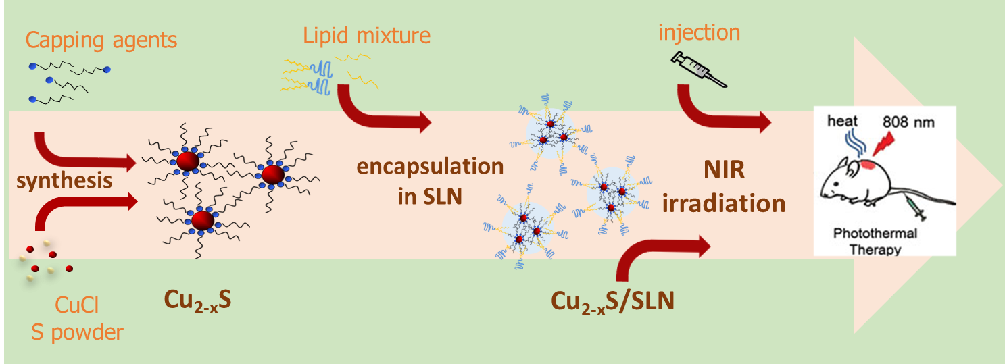
New multifunctional plasmonic nanosystems
GOAL: Fabrication and characterization of a new colloidal multifunctional theranostic nanosystem based on plasmonic copper sulfide nanocrystals (NCs) of type Cu2-xS prepared by a hot injection strategy, incorporated in solid lipid nanoparticles (SLNs) and determination of concentration of SLNs
1064
The resulting new hybrid material is expected to combine the characteristic physical-chemical properties of degenerately doped semiconductors, showing an excitation spectrum with a NIR plasmon band, and the carrier behaviour of SLN

Slide 16
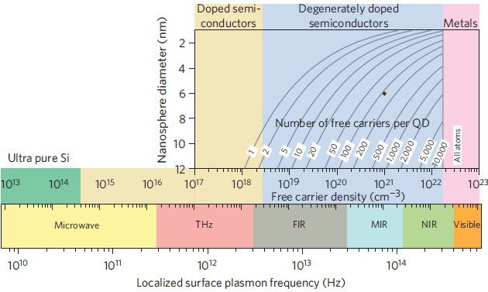
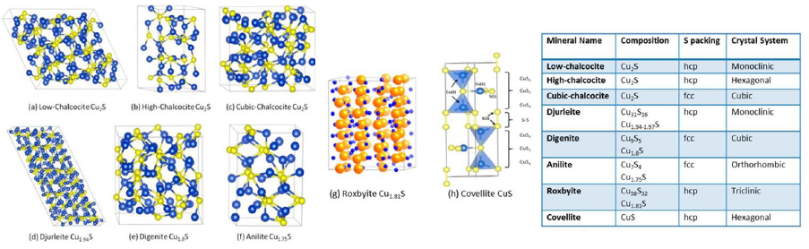
New multifunctional plasmonic nanosystems
Why Non-Stoichoimetric Copper Sulfide NCs?
Easy and large scale synthesis
Low cost
Synthetic and post synthetic modulation of free carrier density: tunable NIR properties
Plasmonic properties in the NIR region achieved for NCs of nearly 3 nm
Tuning LSPR by changing the copper deficiency
Could be used in imaging as agent for photoacustic tomography (PAT) and photothermal therapy extending to a higher penetration depth in vivo
Luther J. M., et al. Nature Materials 10, 2011

Slide 17
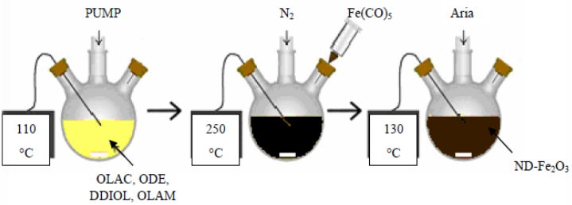

New multifunctional plasmonic nanosystems
Cu_{2-x}S NCs Synthesis - Decomposition of Organometallic Precursor in Hot Coordinating Solvents
CuCl Copper(I) Chloride
S Sulphur
ODE 1-Octadecene
OLAM Oleylamine
OLEA Oleic Acid
Injection temperature (T)
120°C
150°C
180°C
30 min
100
180
ODE, OA, S
N₂
Precursor concentration, ligand OLAM/OLEA composition, injection temperature control the final morphological and spectroscopical properties
30 min
10 min
100
180
T
ODE, OA,
OLAM, CuCl
Cu:S 1:1 molar
Liu L., et al. Chem. Mater. 25, 2013
The ‘as synthesized’ Cu_{2-x}S NCs are hydrophobic

Slide 18
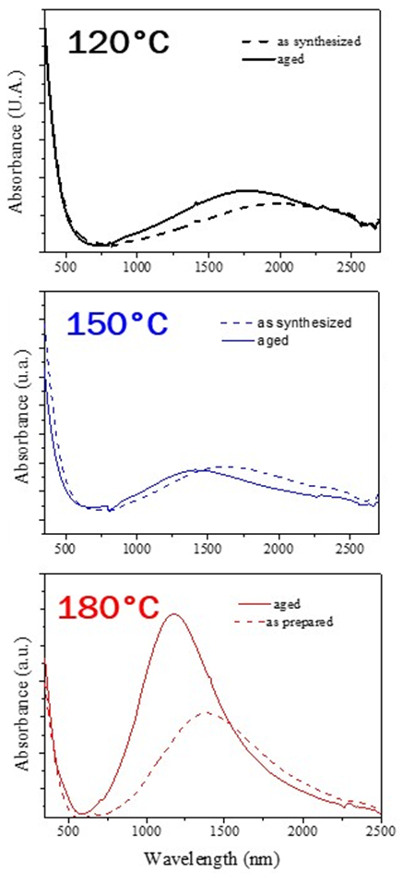
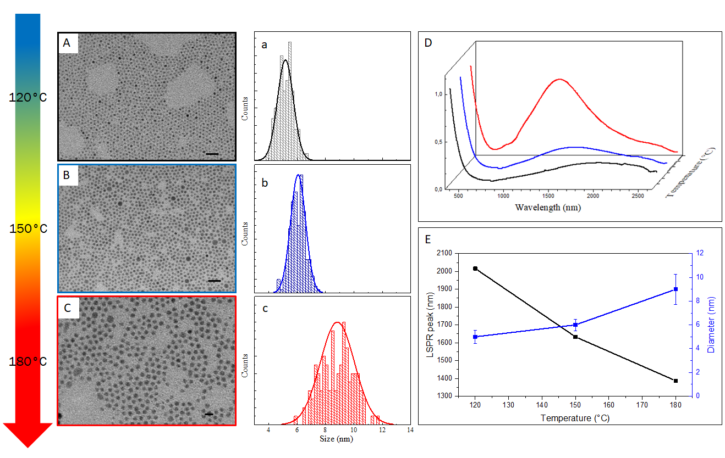
New multifunctional plasmonic nanosystems
Copper Sulfide NCs synthesis: effect of temperature and aging
TEM Analysis
UV-Vis-NIR Absorption
Oxidative effects and variations of density charge due to oxygen molecules on the NC surface
Reaction temperature allows to control dimensions and free carrier density.

Slide 19
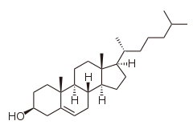
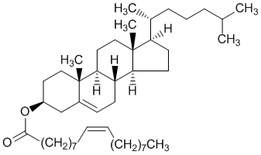
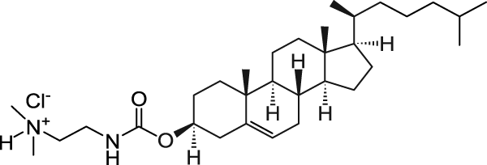
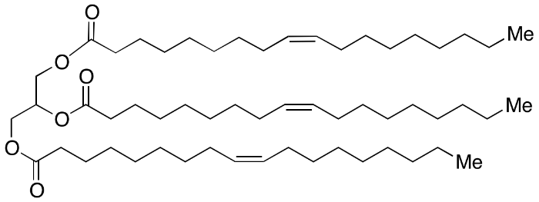
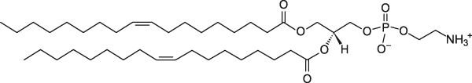


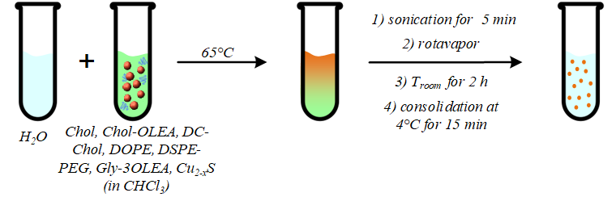
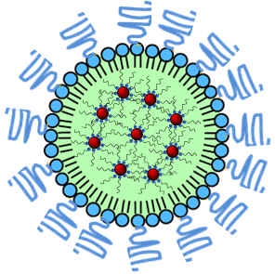
New multifunctional plasmonic nanosystems
Preparation of PEG-coated SLNs Loaded with Cu_{2-x}S NCs - Hot Homogenization Technique
3β–[N-(N’,N’-Dimethylaminoethane)-Carbamoyl]Cholesterol Hydrochloride
Cholesteryl oleate (Chol-OLEA)
Cholesterol (Chol)
DC-Cholesterol (DC-Chol)
DSPE-PEG
1,2–Dioleoyl-sn-Glycero-3-Phosphoetanolamine
Glyceryl trioleate (Gly-3OLA)
DOPE
Cu_{2-x}S NCs
Bae, K. H. et al. Adv. Healthcare Mater. 2, 2013
Grillone, A. et al. Adv Healthcare Mater. 4, 2015

Slide 20
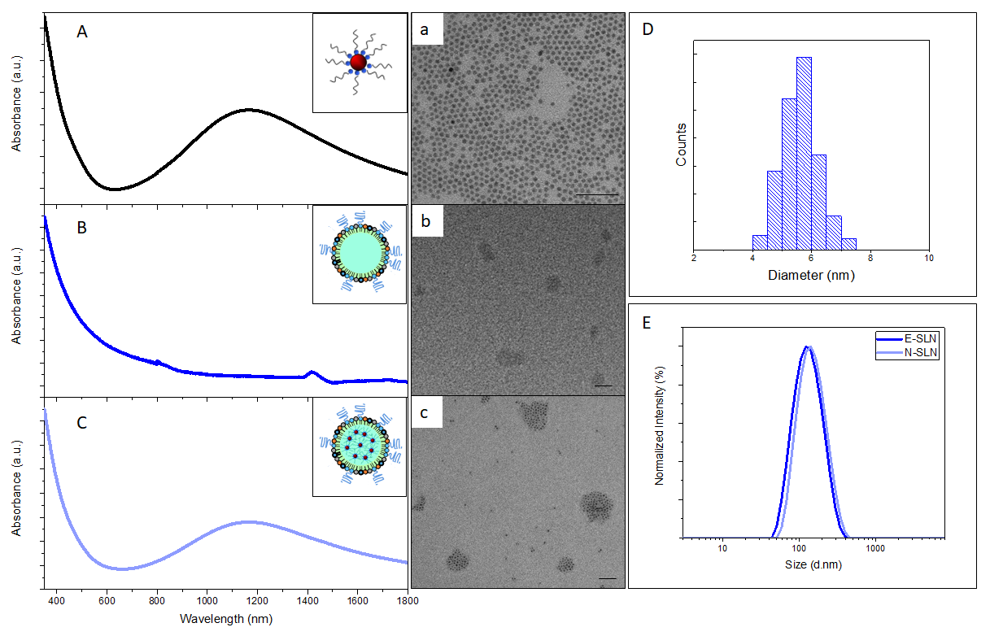
New multifunctional plasmonic nanosystems
Characterization of PEG-coated SLNs Loaded with Cu_{2-x}S NCs
UV-Vis-NIR Absorption
TEM Analysis
Statistical Analysis
Sample | Cu_{2-x}S (%) | d_{H} (nm) | PDI | ζ (mV)
E-SLN | - | 112.4 ± 3.0 | 0.196 ± 0.024 | +62.0 ± 0.3
N-SLN | 35.7 | 144.8 ± 0.7 | 0.217 ± 0.016 | +61.4 ± 0.5
E-SLN
Effective encapsulation of Cu_{2-x}S NCs into SLN, preservation of plasmonic properties, low polydispersity and high colloidal stability.
Dynamic Light Scattering (DLS)
N-SLN

Slide 21

Thank You
For Your Attention
IPCF-CNR c/o Dipartimento di Chimica – Università degli Studi di Bari, Via Orabona 4 – 70126 BARI
f.vischio@ba.ipcf.cnr.it
347/1418416

